Slide 1
Introduction to Linux
Cybersecurity
Lesson 3.1

Slide 2

Class Objectives
By the end of class, you will be able to:
1
Name three of the most important distributions of Linux.
2
Navigate the Linux file structure by using the command line.
3
Discuss the prominence and utility of the command line for IT and security.
4
Use commands for basic file navigation and manipulation.
5
Navigate deeply nested folder structures using file paths.

Slide 3

So, Why Linux?

Slide 4
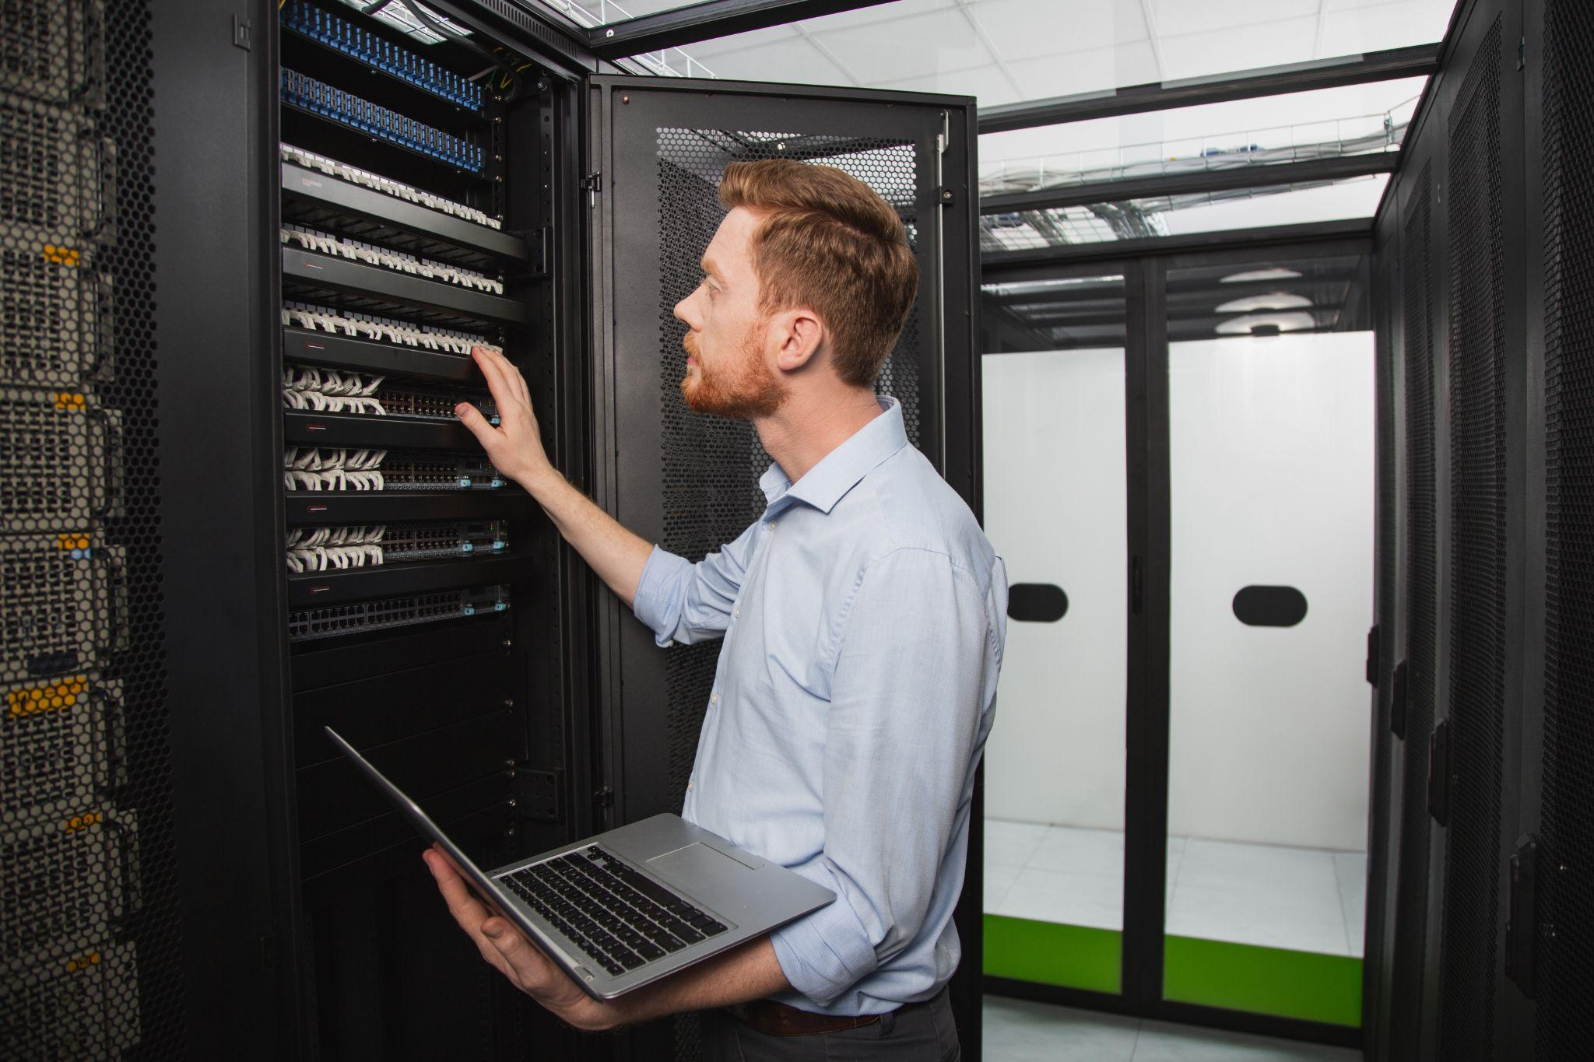
Why Linux
Millions of websites run
a version of Linux.
w3techs.com
Notes:
https://www.shutterstock.com/image-photo/technicians-examining-equipment-network-server-room-2216456543

Slide 5

Why Linux
The ubiquity of Linux machines on modern networks makes it a common target for attackers.
Notes:
shutterstock_534253945

Slide 6
Familiarity with the operating system is crucial for cybersecurity professionals.

Slide 7
Linux in a Professional Context
Knowledge is essential for the following technical roles, among others:
Helpdesk/IT support
System administration
Penetration testing
Network forensics

Slide 8
Have you ever used Linux before? In what context?

Slide 9




Common Linux Applications
Web servers and websites
Smartphones
Embedded systems
Government and military systems

Slide 10
In our previous class, we discussed various AI platforms and technologies.
Linux plays a pivotal role in the AI landscape.

Slide 11

Linux History and Distributions

Slide 12
A (very) Brief History of Linux
In 1969–1970, Dennis Ritchie, Kenneth Thompson, and several others at AT&T Bell Labs began developing a small operating system called Unix.
01
Within the next two decades, different updates and distributions of Unix were created. Most were proprietary.
02

Slide 13
A (very) Brief History of Linux
In 1984, Richard Stallman's Free Software Foundation (FSF) started the GNU project, which created a free distribution of the Unix operating system.
03
In 1991, Linus Torvalds used many of the components from the GNU project to create a free, open source operating system, now known as Linux.
04

Slide 14
An operating system (OS) is the software that supports a computer’s basic functions, such as scheduling tasks, executing applications, and controlling peripherals.

Slide 15


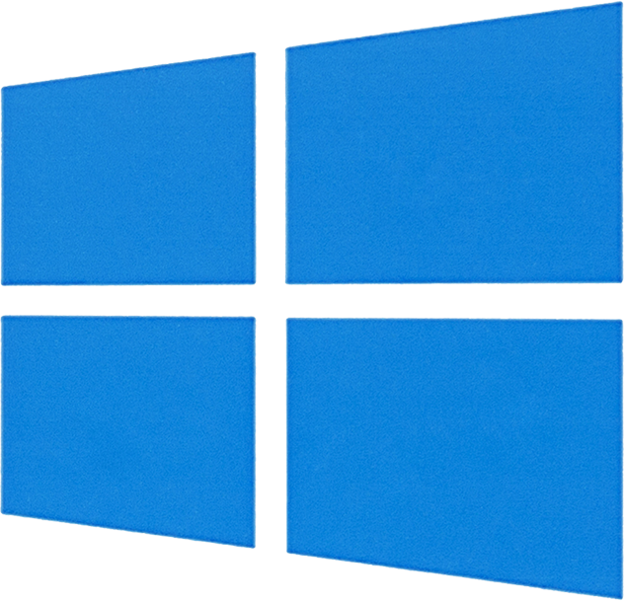
Examples of Operating Systems (OS)
01
02
03
Windows
macOS
Linux
Notes:
Shutterstock_792833623 shutterstock_693068344 shutterstock_693068344.png

Slide 16

Why Linux?
Unlike Windows and OS X, Linux is Free, Open Source Software (FOSS).
  Anyone can modify the source code.
Most tools in the hacker/security community are still published as open source.
Free software and information is prevalent in the industry.
  This includes almost all the tools we’ll use in class.

Slide 17
Distributions are special-purpose variants of the operating system.

Slide 18


Linux Distributions
In this course, we’ll use two distributions: Ubuntu and Kali Linux.
Ubuntu
Kali Linux
Ubuntu is geared towards general-purpose users.
Kali is designed specifically
for security professionals.

Slide 19

Linux Distributions
Ubuntu and Kali Linux are both specialized distributions of Debian, which is itself a distribution.

Slide 20

Command Line
In order to conserve as many resources as possible, most production Linux servers don’t offer a graphical interface.
Therefore knowledge of the command line is essential for understanding Linux.
Notes:
shutterstock_185734466

Slide 21

Command line-only machines are called headless servers.
Benefits of headless servers:
Require very few resources
Give the server maximum resources to run its services and applications
Do not require GUI-based system
>_
Notes:
shutterstock_1202854222

Slide 22

Distribution Research
You are a system administrator at X Corp, which has recently experienced a number of breaches involving servers running outdated Linux distributions.
In response, the IT Department has decided to upgrade the affected servers with newer distributions of Linux.
You must conduct research to determine which distribution is most appropriate for each machine.
15 Minutes

Slide 25

Linux File System Structure

Slide 26
Linux File System Structure
Conventional file system structure
Consistent conventions across distributions
Mostly uses bash shell by default

Slide 27
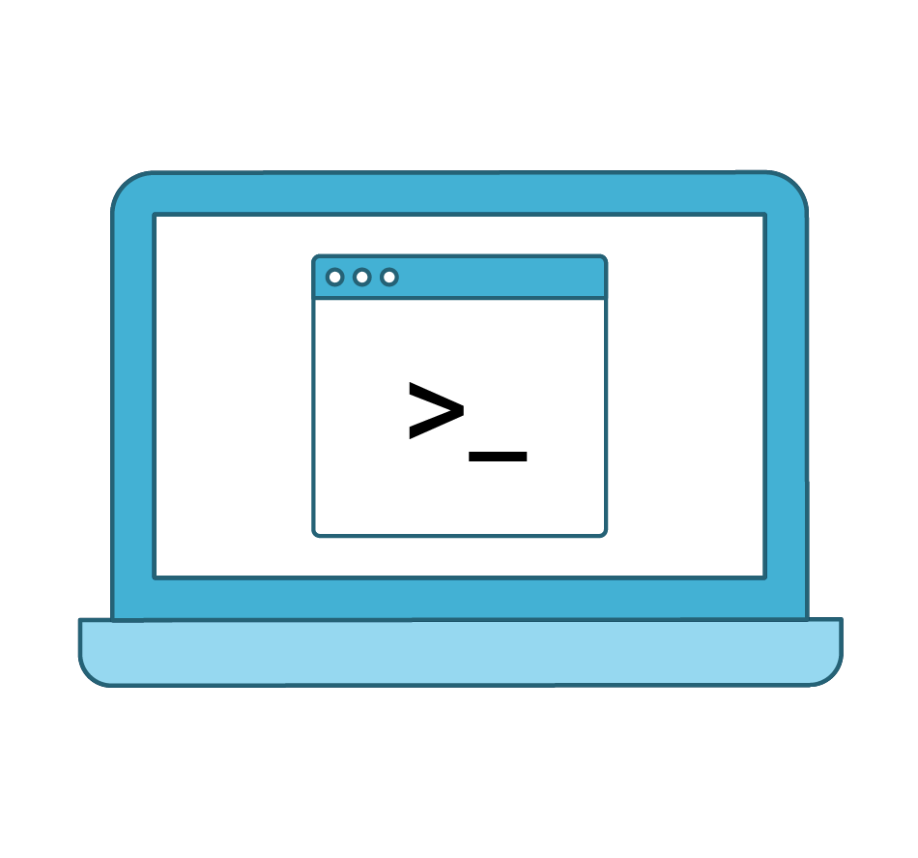
Root
Root can have multiple meanings in Linux. Depending on the context, root can be either:
The user account for the administrator
The root directory that contains every other directory
The home directory for the root user

Slide 28
File Systems
Linux maintains certain conventions for storing files:
/ | Contains every other directory.
/home | Contains users’ private files. Users should not be able to save files elsewhere.
/root | The home directory of the root user.
/etc | Contains configuration files, defining how a machine runs and who can use it.
/bin, /sbin | Contains main binary or program files.
/var | Contains files that change over time.
/tmp | Contains files that are only needed for a short period of time.

Slide 29

Instructor Demonstration
Tour Linux File System

Slide 30
Demo Takeaways
The audit took us to the following directories:
/etc | Stores specific, system-wide configuration files, as well as the most sensitive files on a Linux system
/var | Stores files that are continually updated
/home | Stores user home folders
/tmp | Where applications write temporary files that can be deleted on reboot
/bin and /sbin | Where the system keeps its main binary or program files

Slide 31
Why Terminal Matters

Slide 32

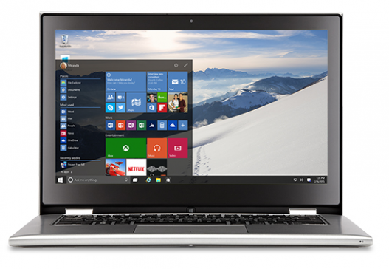
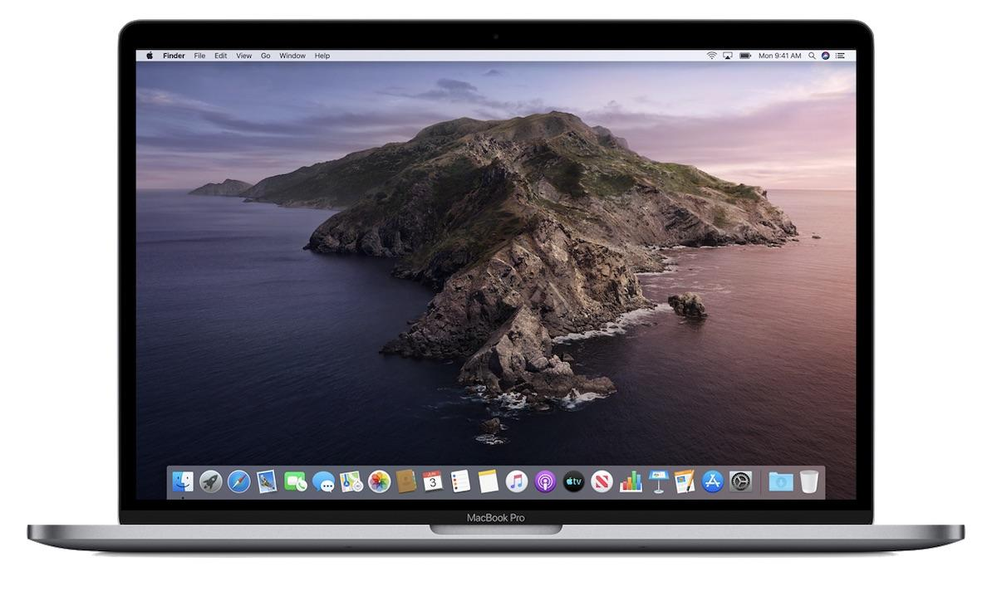
Graphical User Interfaces
We are used to GUIs with their familiar icons, windows, buttons, and mouse pointers.
Mac
PC
Text

Slide 33
Raise a Fist: If you’ve never worked with the command line and barely know what it is
Raise a Five: If you work with the command line on a daily basis
Raise One, Two, Three, or Four: If you fall somewhere in between

Slide 34
What is the
command line?

Slide 35

What Is the Command Line?
Command line users don’t directly interact with icons and buttons on the screen.
Users complete tasks on their computers by issuing commands in the terminal.
Sams-MacBook-Pro-2:~ sam$ cd Documents
Sams-MacBook-Pro-2:Documents sam$ ls
Assessment.docx Day-1-Notes.docx
Project-1 Homework-1.docx
Project-2 Homework-2.docx
Sams-MacBook-Pro-2:~ sam$ cd Documents/Project-1
Sams-MacBook-Pro-2:Project-1 sam$ ls
Assessment.docx Presentation Notes.docx Report.docx
Sams-MacBook-Pro-2:Project-1 sam$ open Report.docx

Slide 36
Why the Command Line?
Using the command line is a critical skill. At different times, it may be:
01
02
03
The only way to achieve a desired outcome
The fastest way to achieve a desired outcome
The most flexible way to achieve a desired outcome

Slide 37

Why the Command Line?
Using the command line is a critical skill. At different times, it may be:
01
The only way to achieve a desired outcome
You may have to work with systems and tools that have no GUI interface.

Slide 38
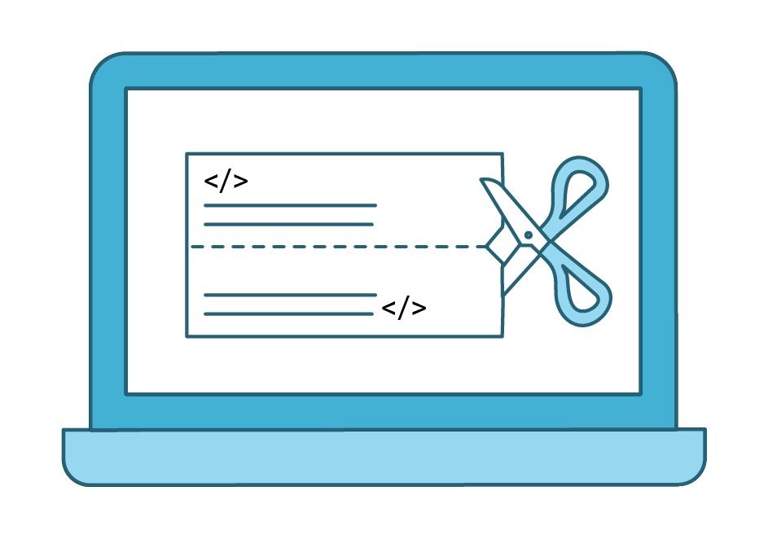
Why the Command Line?
Using the command line is a critical skill. At different times, it may be:
The fastest way to achieve
a desired outcome
02
The command line has tools that can speed
up a task.

Slide 39

Why the Command Line?
Using the command line is a critical skill. At different times, it may be:
The most flexible way to achieve a desired outcome
03
Working directly with the command line provides greater control.

Slide 40

Words to the Wise
A few things to remember
The best way to learn the command line is to use it.
This section is heavily focused on practical activities.
Take notes during each demo and try your best on activities.
Remember: Practice makes perfect!

Slide 41
Activity Scenario
Welcome to Candy Corp
You are a security analysts at a candy manufacturing company called Candy Corp.
You will be using the command line to investigate a potential rogue employee who may be selling secret Candy Corp recipes to a rival organization, Sugar Corp.
You will be tasked with using the command line to identify evidence on the system of suspicious activity from this rogue employee

Slide 42
Instructor Demonstrati
Common Text Commands

Slide 43

Basic Terminal Commands

Slide 44
Basic Commands
In the next demo, we’ll cover the following text commands:
pwd | Displays the current working directory (“print working directory”)
ls | Lists directories and files in the current directory
cd | Navigates into a directory (“change directory”)
mkdir | Makes a directory
rmdir | Removes a directory
touch | Creates an empty file
rm | Removes a file
clear | Clears the terminal history of a page
echo | Displays text on the terminal
history | Displays a list of commands previously run

Slide 45
Common Terminal Commands

Slide 46
Demonstration Review
What does each of the commands do?
pwd | Displays the current working directory (“print working directory”)
ls | Lists directories and files in the current directory
cd | Navigates into a directory (“change directory”)
mkdir | Makes a directory
rmdir | Removes a directory
touch | Creates an empty file
rm | Removes a file
clear | Clears the terminal history of a page
echo | Displays text on the terminal
history | Displays a list of command previously ran

Slide 47
Take Five and Practice the Command Line
In this activity, you are a security analyst at Candy Corp.
Candy Corp believes an employee is selling secret recipes.
You must create evidence directories for email, logs, and web access to organize your investigation.
20 Minutes

Slide 51

Relative vs. Absolute Paths

Slide 52
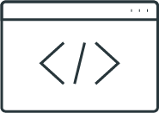
File Paths
A file path is a unique location in the file system where a file is located.
The cat.jpg image file is located in the my_images directory, which is in the Desktop directory, in the Sally directory, in the home directory
/home/Sally/Desktop/my_images/cat.jpg
The directory path is /home/Sally/Desktop/my_images/
The file is an image called
cat.jpg

Slide 53
File Paths in IT
You are a security administrator and need to access a network log for an investigation.
You might ask the network team for the location or path of the file.
The network team would provide you with a file path such as:
/var/log/logfile1.txt

Slide 54
File Paths
Absolute paths
Relative paths
A relative path starts at your current location in the file system and doesn't require using the root directory ("/").
There are two types of file paths:
01
02
An absolute path indicates the location of a file regardless of your current location in the file system.
/home/Sally/Desktop/Sallysfiles/textfiles/Sallyfile.txt
Sallysfiles/textfiles/Sallyfile.txt

Slide 55
Absolute Paths
We want to access a file located at:
/home/Sally/Desktop/Sallysfiles/textfiles/Sallyfile.txt
If we are located in a different directory, such as:
/home/bob/file_logs/
We can use the absolute path:
/home/Sally/Desktop/Sallysfiles/textfiles/Sallyfile.txt

Slide 56
Relative Paths
We can utilize the dotslash
We can utilize ./ to indicate a relative path from our current location:
  . indicates current directory
  / start of the relative path
If we are working in the directory:
/home/Sally/Desktop
To Access Sallyfile.txt, you can use:
./Sallysfiles/textfiles/Sallyfile.txt

Slide 57
File Paths on the Command Line
Relative and absolute paths function as helpful shortcuts on the command line.
cd Desktop/Sallysfiles/textfiles/
cd Desktop
cd Sallysfiles
cd textfiles

Slide 58
Instructor Demonstration
Relative and absolute paths

Slide 59
Demonstration Scenario
Our manager at ACME Corp needs us to create several additional evidence files for our investigation. They provide the following instructions:
1
Navigate to the directory /03-instructor/day1/pathnav_demonstration/security_evidence/Case2/.
Create an empty file called case2_evidence.
2
Navigate to the directory Case1 and create an empty file called Web_logs.
3
Navigate back to the home folder.

Slide 60

Copying and Moving Files

Slide 61
Security and IT professionals are often asked to copy files from one location to another.

Slide 62




Copying Files
The command “cp” creates a copy of the file.
A copy is placed in new location.
The original file is located in the directory.
The cp (copy) command is entered on the terminal.
The original file remains in current directory.

Slide 63
Moving Files
The command “mv” moves the file from the current location into a new location.
A file is located in the directory.
The mv (move) command is entered on the terminal.
The file is moved from the current directory to a new location.
Remember: Unlike cp, the original file doesn’t remain.

Slide 64
Similar Syntax
<command> <file> <location to copy or move>
cp cat.jpg /dirA
mv dirA/dirB/dirC/cat.jpg
/dirA/dirB
This command copies the file cat.jpg into the directory dirA.
The <file> or <location> can be indicated with an absolute or relative path.
This command moves the file cat.jpg from the dirC directory over to the dirB directory.

Slide 65
Instructor Demonstration
Copy and Move Files

Slide 66
Let’s Review
Let’s review the following concepts and commands:
File path | Identifies a unique location in a file system
Absolute path | Starts at the top directory of the file system
Relative path | Begins from the current directory
cp | Copies files
mv | Moves files

Slide 67
Find your Milky Way
Continue in your role as a security analyst at Candy Corp.
Your manager at Candy Corp needs you to create an additional directory, as they believe there is a second employee working with Sugar Corp.
You must also copy and move several of the evidence files after creating this new directory.
20 Minutes

Slide 70

Recap
In today’s class you:
01
Discussed Linux distributions
02
Navigated Linux file structure using command line
03
Described utility of command line in security professions
04
Performed basic file manipulation
05
Discussed relative and absolute file paths

